Slide 1


Smart Beach at Bruce County
Sanjeev Kumar - Professor
Brunilda Xhaferllari – Project Manager
Rich Freeman – Faculty Mentor
AI Team:
Janvi Patel
Fangji Chen
Notes:
Image: Sunrise Over Beach in Cancun Stock Image - Image of sunrise, beach: 40065727 (dreamstime.com)

Slide 2
Content
Project Objective
Project Methodology
Architecture
Future Work

Slide 3

Project objective

Slide 4
Project objective
This project is part of the three-year Smart Beach project administered by Bruce County. It aims to use innovative technologies to improve beach safety. Launched at Station Beach in Kincardine on May 25, 2022, the research team of the Smart Beach project has collected weather and wave data using a RAEON (Real-time Aquatic Ecosystem Observation Network) buoy in Lake Huron from Spring to Autumn in 2022.
Predicting the weather and wave condition makes it easier to decide for people who are planning to visit beach for swimming purpose.
The main goal of the project is to work on following questions.
Predict the number and distribution of people on the beach and in the water. Data provided: anonymized images from the camera. This will be provided later once the images are anonymized, with a focus on providing the model set first.
Predict the wave conditions and current visible in the camera images.

Slide 5

Project methodology

Slide 6
Project methodology
The very first step was to determine the type of data and work needs to be done on the data before implementing any algorithm.
Without any prior knowledge of images, the very first thing that comes to our mind is the security of the data. Which can be obtained by Image anonymizing.
After Image anonymizing, we have looked for images with all possibilities and generated a dataset to initially start our work on.
These possibilities included different camera angles, Different crowd densities, Different day and night time, Different seasons.
The research done by the team was based on this dataset. Including all the possibilities in the dataset, we have discovered solutions for all kinds of Images.
We have an architecture that will work in any situation.
After receiving the actual beach data of bruce county, we decided to eliminate some phases from the architecture which were not necessary as well as it helped reducing the use of resources.

Slide 7
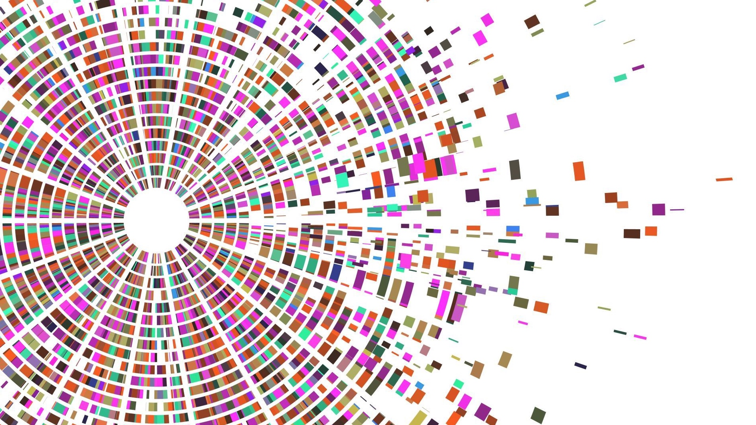
Architecture

Slide 8
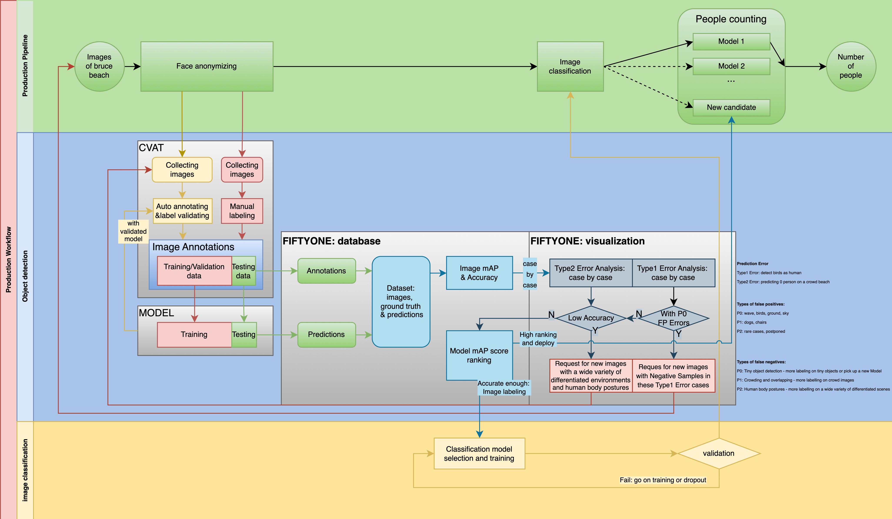

Slide 9
Architecture
Face anonymizing
Image annotation
Model training/validation
Image classification
Object detection

Slide 10
architecture
Face anonymizing
Image annotation
Model training/validation
Image classification
Object detection

Slide 11
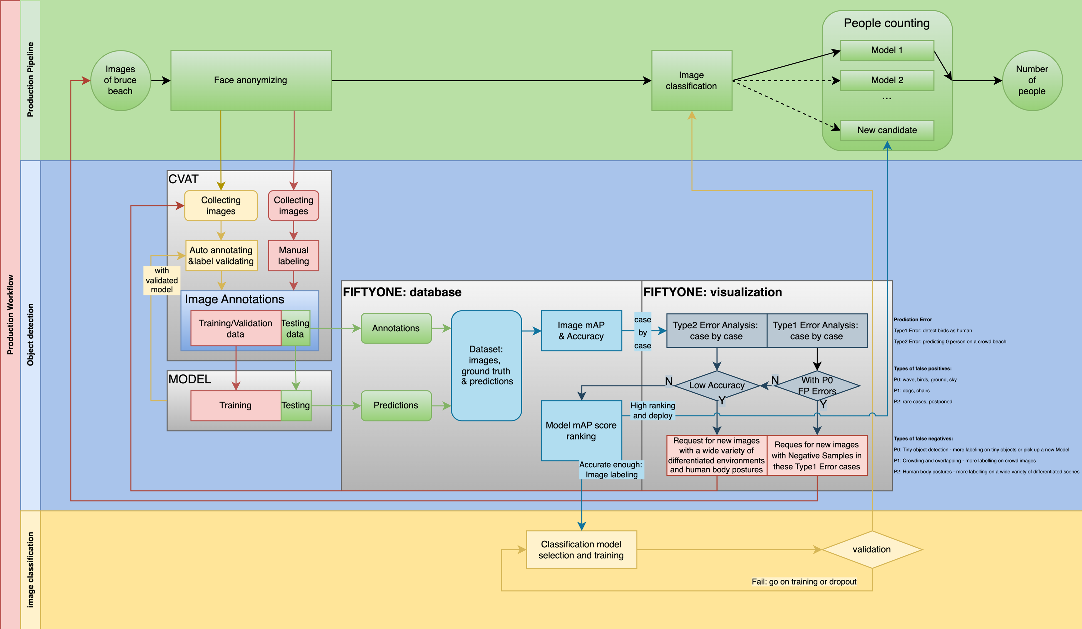
Face anonymizing
1
Anonymizing:
To protect people’s privacy

Slide 12
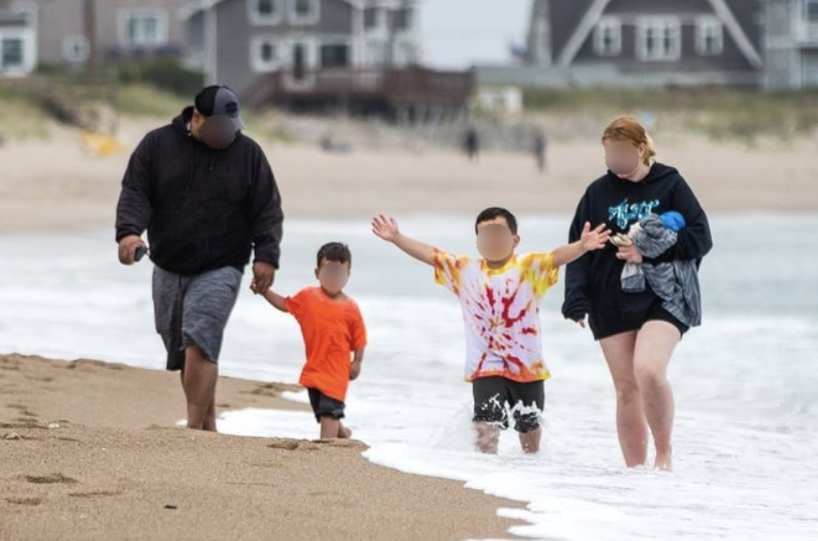
FACE ANONYMIZING
According to our research, face anonymizing plays an important part in the performance of object detection.
Heads are the most recognizable feature to detect people thus we need to handle them with care and avoid losing too much information when anonymizing.
So, we have created our own algorithm to detect faces in the body of a person who is clearly visible and blur them.
unknown(2014)

Slide 13
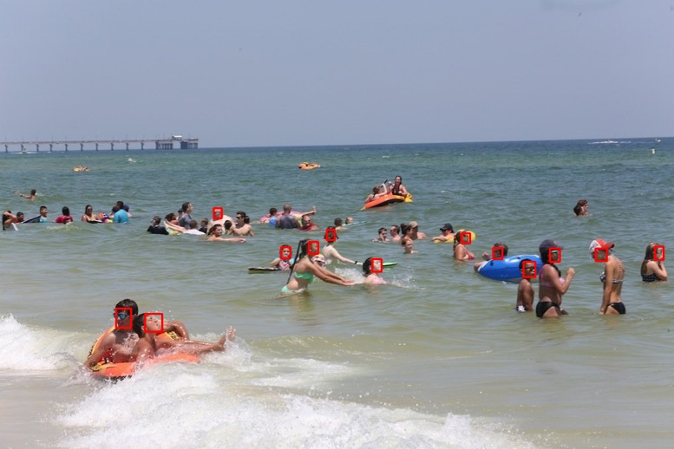
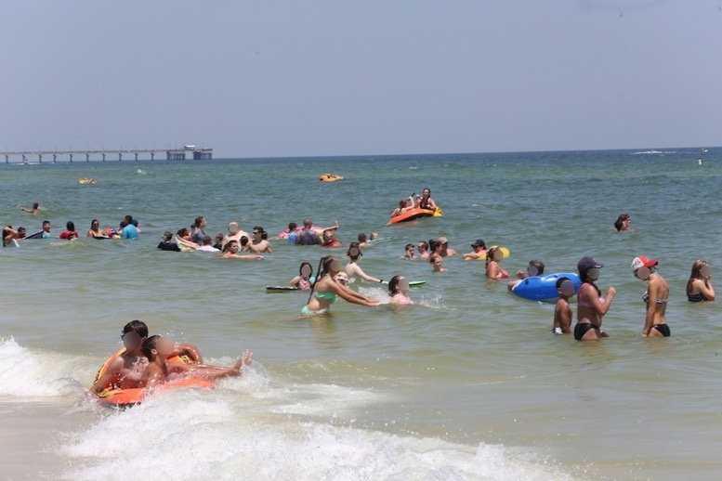
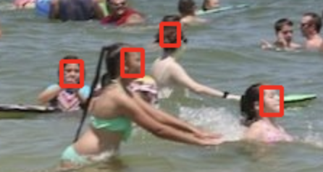
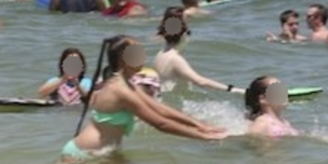
Face Anonymizing protects people’s privacy Patterns of heads

Slide 14
architecture
Face anonymizing
Image annotation
Model training/validation
Image classification
Object detection

Slide 15
Image annotating
2
Manual labeling
Auto labeling

Slide 16
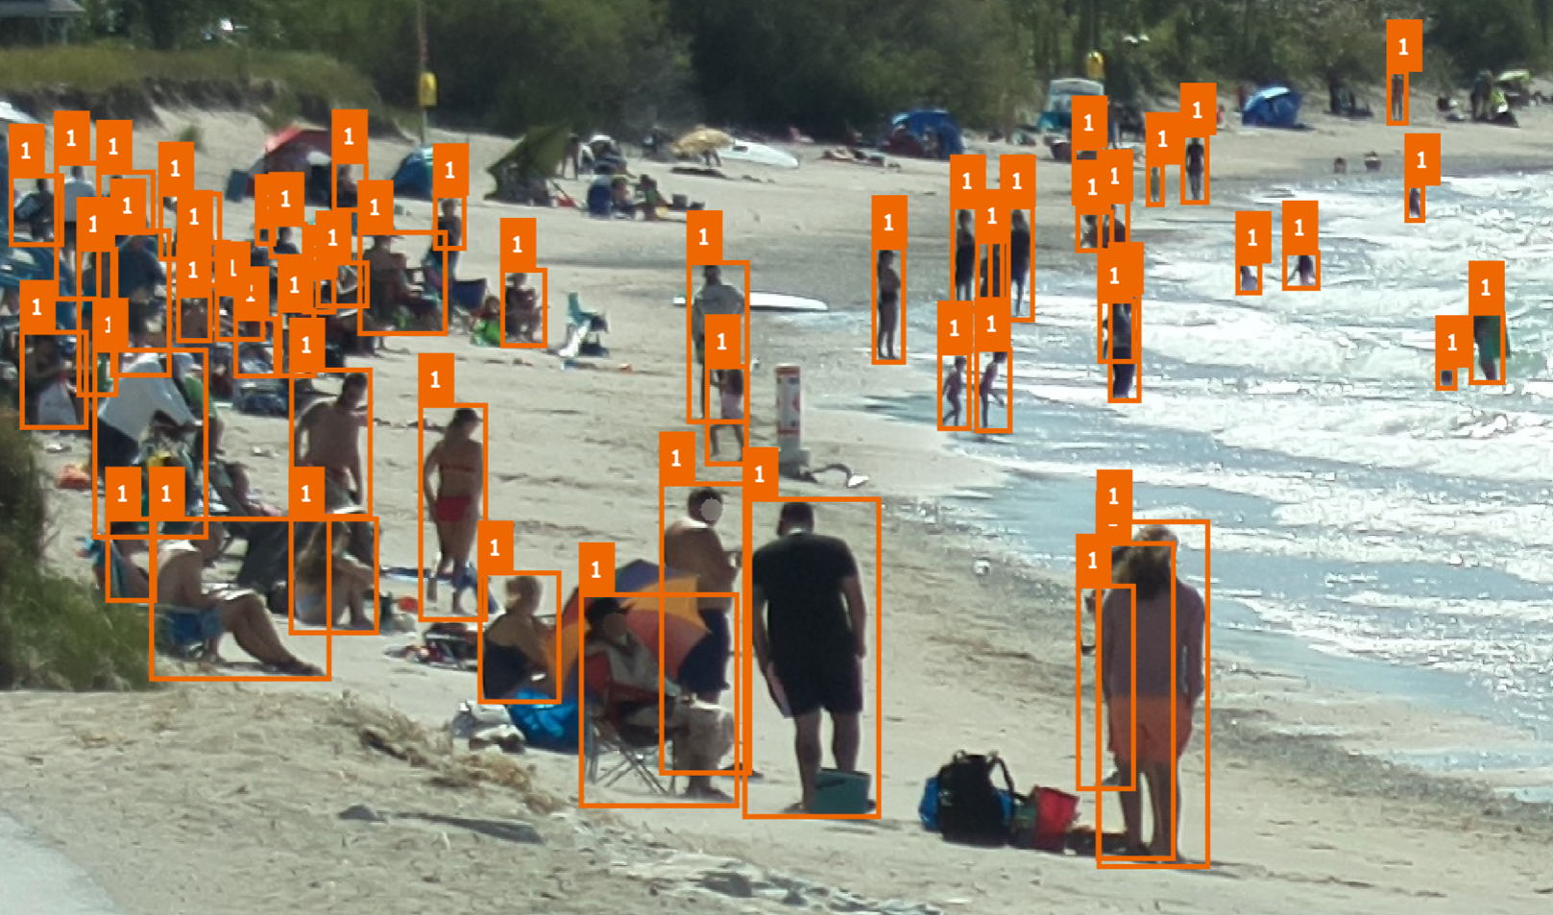
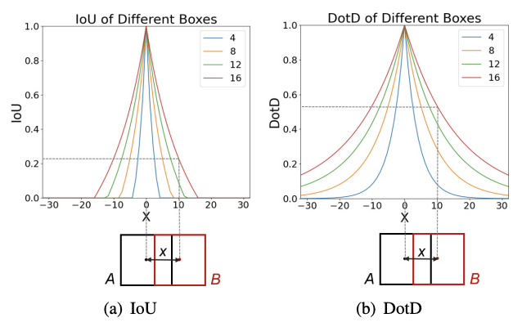
Annotation
What is an annotation: using human knowledge to annotate ground truth on raw images
Typically, it is called a bounding box.
The benefit of it is a bounding box can be formed with 4 numbers: [x, y, w, h] or [x1,y1,x2,y2], etc.
Besides, a bounding boxes should be tight to the edge of a person because the IoU score is sensitive to the overlapping area between prediction and ground truth.
2022-09-02_13-50-14.png
Chang Xu, CVPR 2021, Dot Distance for Tiny Object Detection in Aerial Images.

Slide 17
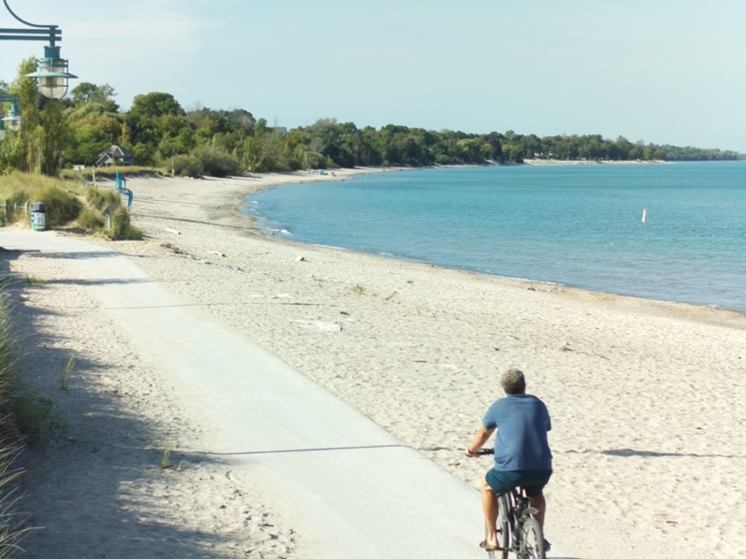
Data preparation in details
Training samples should be carefully selected:
Different days, and seasons: to include different climates, etc.
Different hours in a day: to capture all the details, for example, lights, birds, waves, etc.
Different people scales: no matter it is crowded with hundreds of people or empty
2022-08-27_15-20-15.jpg
2022-10-09_18-40-16.jpg
2022-10-11_08-40-16.jpg
2022-08-28_10-00-15.jpg
2022-10-10_10-20-16.jpg
2022-10-11_07-10-16.jpg

Slide 18
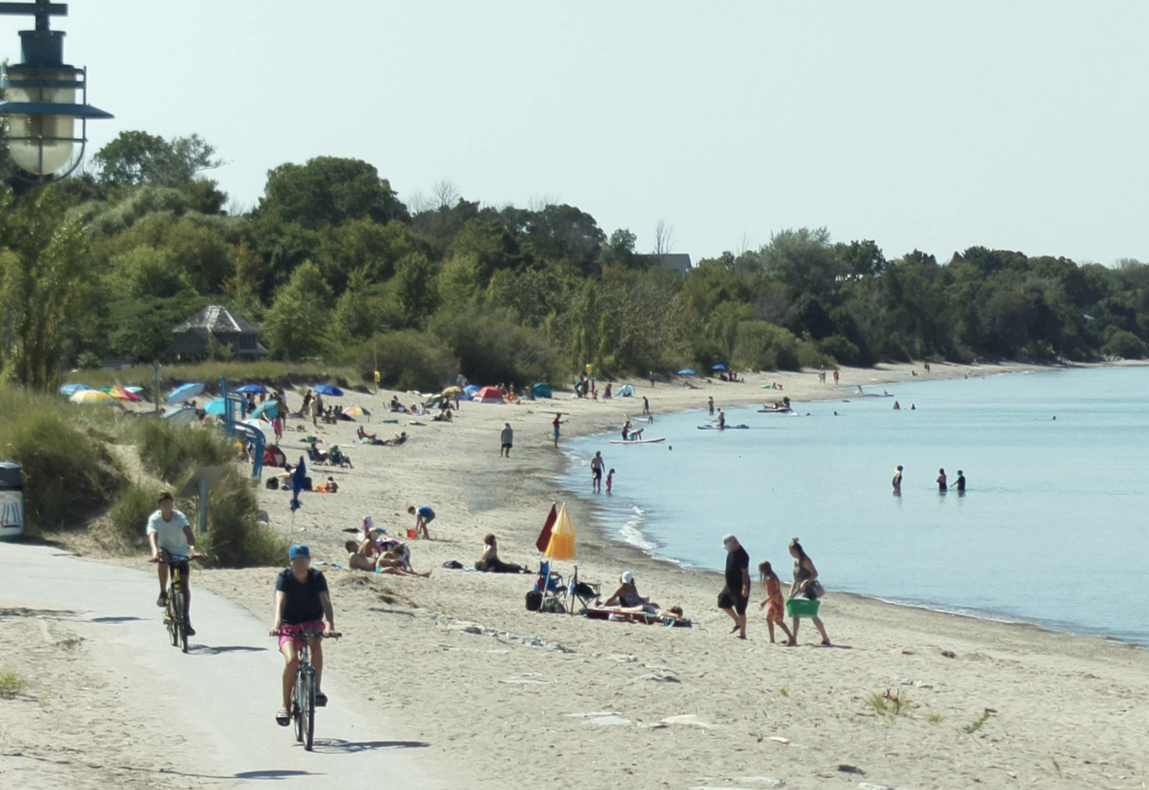
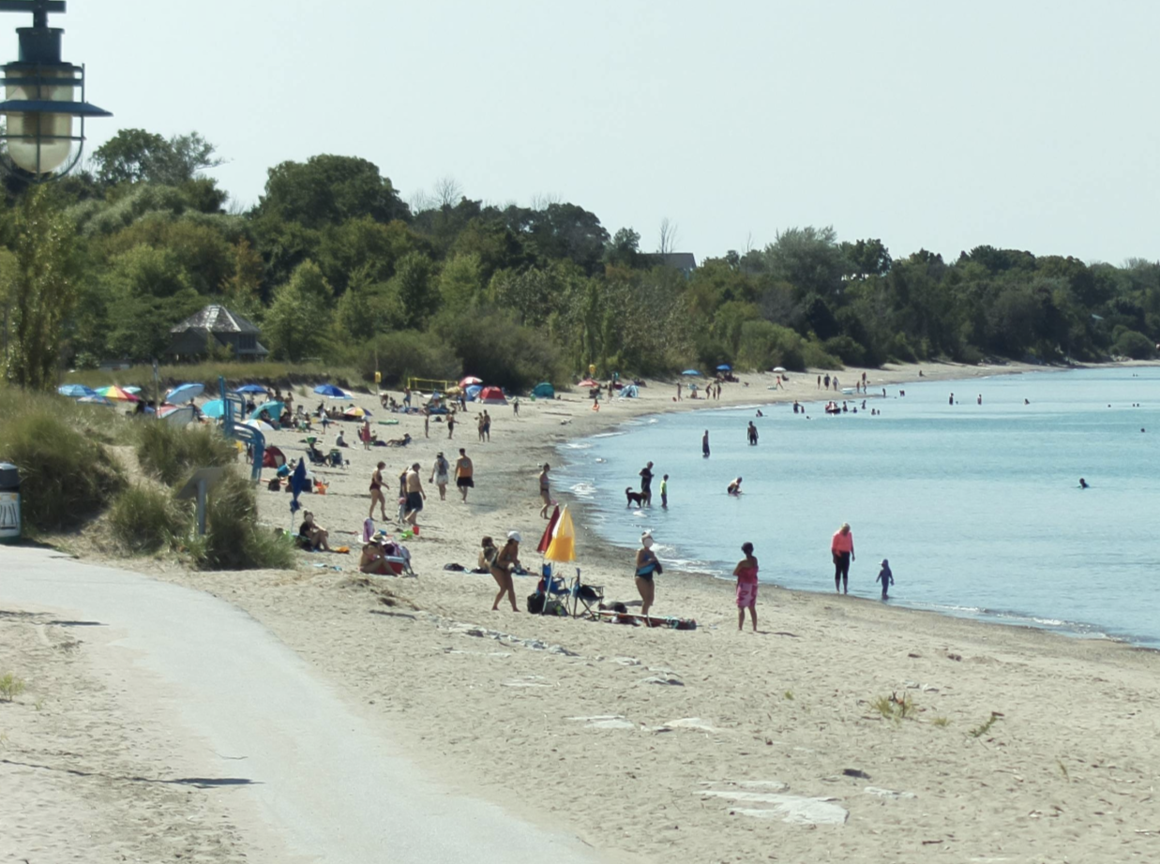
Data Splitting
Images are not i.i.d(independent and identically distributed) to each other
Similar people distributions
Similar circumstance conditions
Dataset splitting:
In order to avoid this kind of overfitting, we suggest choosing training data, validation data, and test data from different days.
2022-08-27 12-10-15.jpg
training | validation | test
60% | 20% | 20%
2022-08-27 12-30-16.jpg

Slide 19
architecture
Face anonymizing
Image annotation
Model training/validation
Image classification
Object detection

Slide 20
Model Training
training data: 60%
validation data: 20%
test data: 20%
3

Slide 21
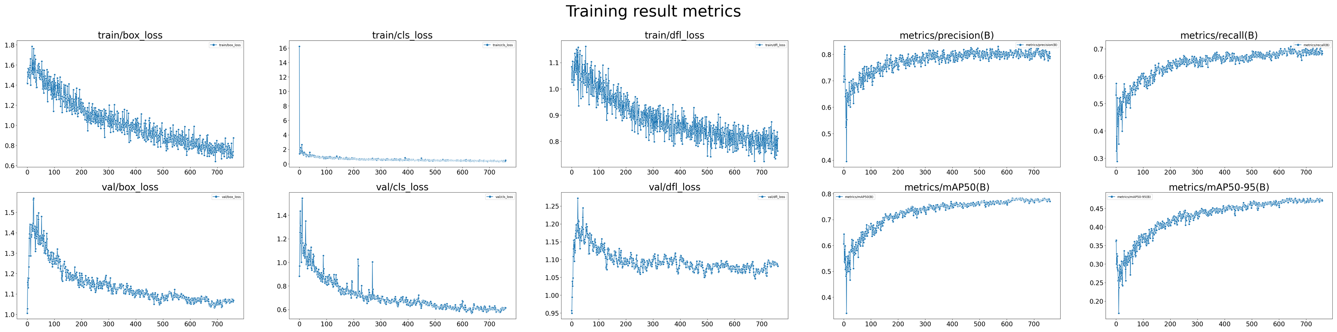
Model training
Training dataset: 259, bounding boxes 8009, human density 30.9
Validation dataset: 90, bounding boxes 2676, human density 29.7
Test dataset: 77, bounding boxes 2266, human density 29.4
Training result: mAP 0.477
Test result: mAP 0.404

Slide 22
test data Analyzing in a glance
Before we continue with our validation, we should find out the bad cases from this stage
4

Slide 23
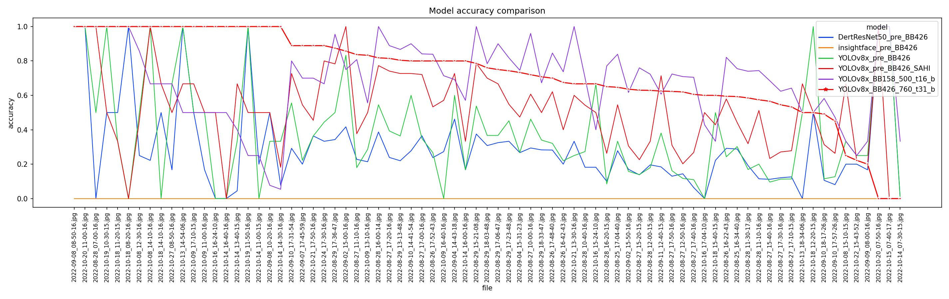
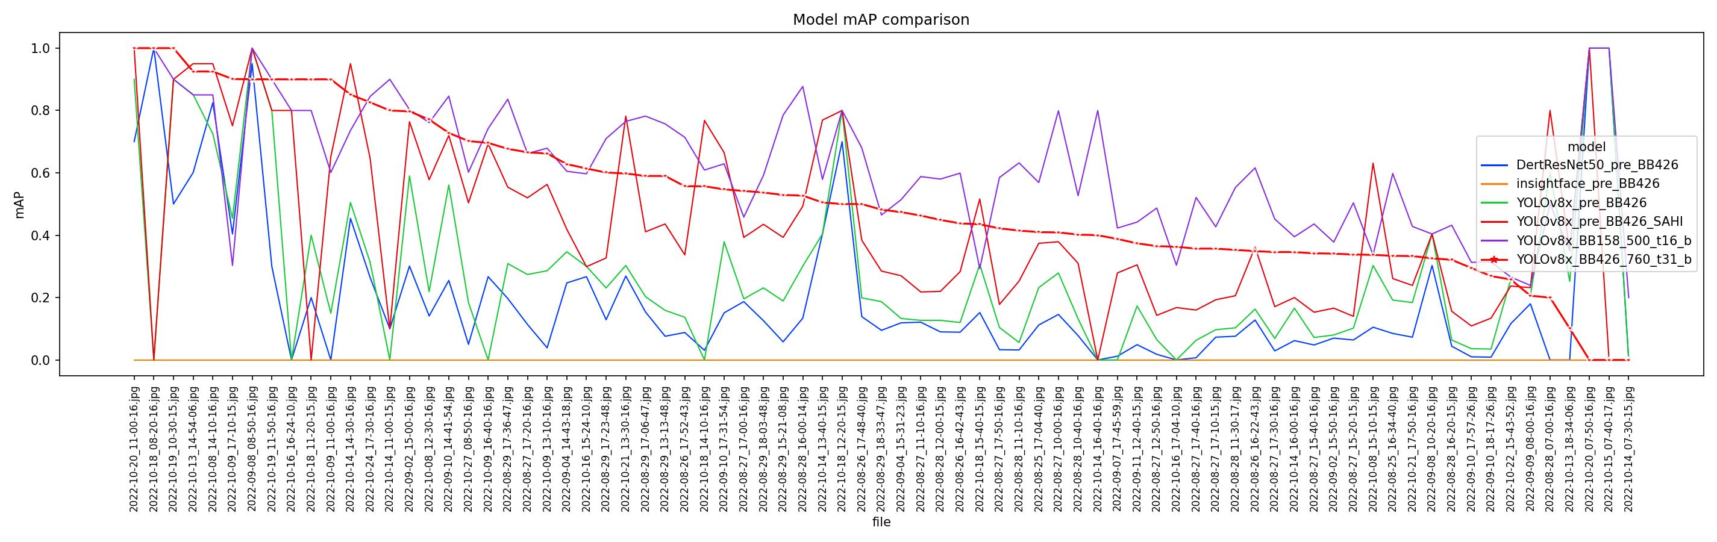

Slide 24
case by case analysis
What is a bad case?
P0: wave, birds, ground, sky
P1: dogs, chairs, dead-wood bringing by the storm
P2: rare cases, will be postponed
5

Slide 25
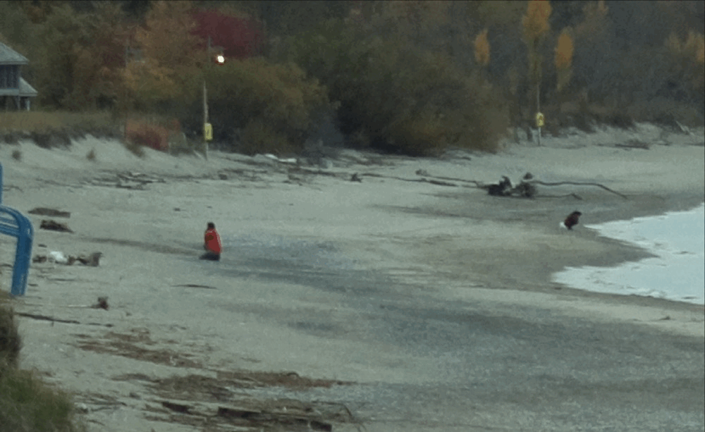
Bad annotation:
Wrong area of a bounding box may lead to a failure when applying IoU on validation
Dead-wood
Squatting girl
Dead-wood

Slide 26
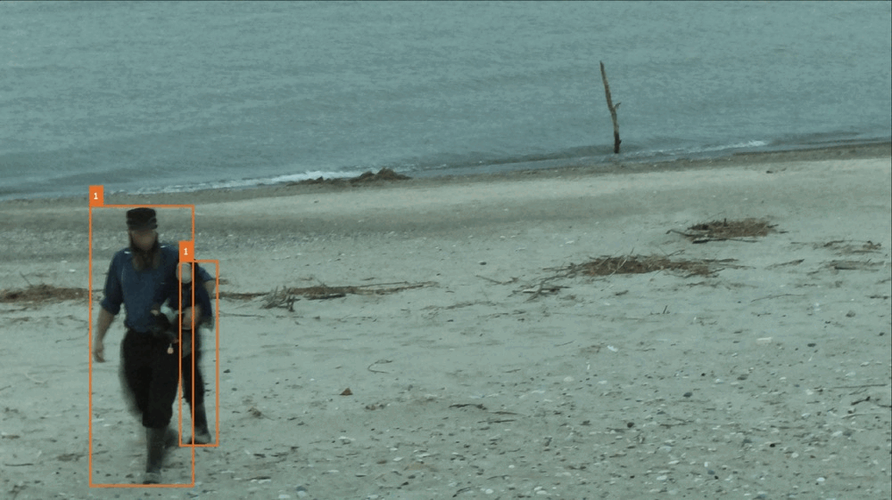
Bad prediction:
Tiny rock

Slide 27
What to do after case analysis?
After case-by-case analysis, now it’s time to make a better dataset and retrain again.
6

Slide 28
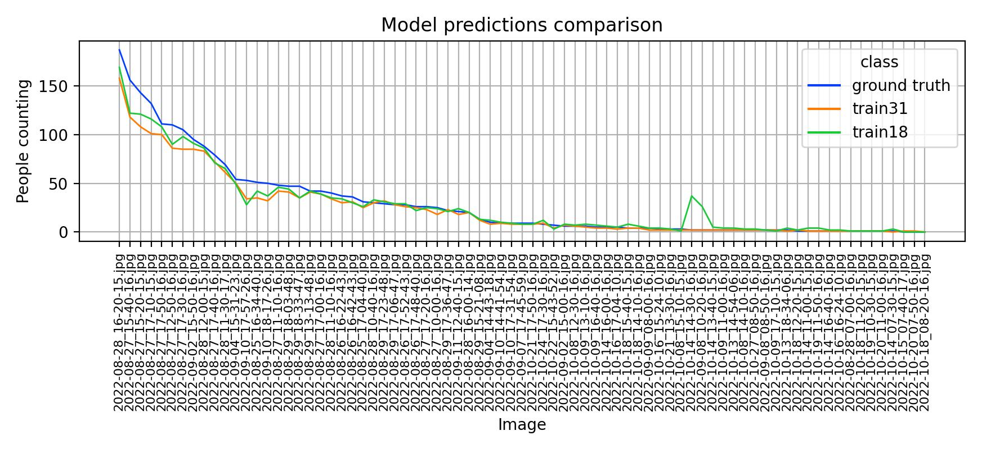
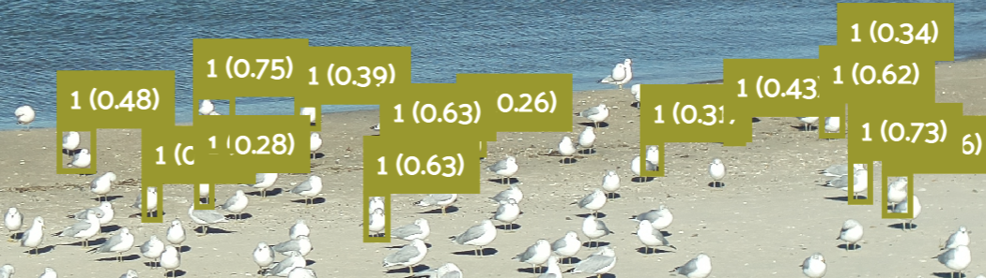
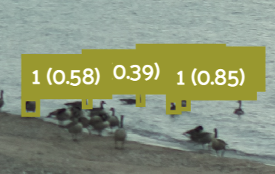

Continue validation After model retrain now the type 1 error fixed

Slide 29
AP score and deployment
After several rounds of validation and retraining, we finally go to this stage: publish our model and new ground truth for image classification
7

Slide 30
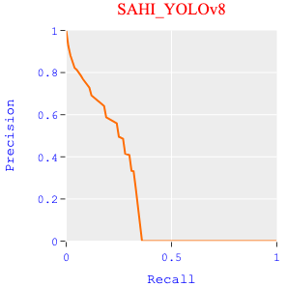
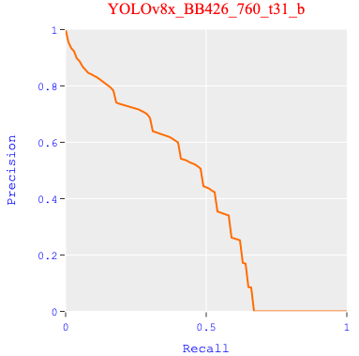
Power of Training
Training with the Bruce Beach dataset makes a significant improvement in the performance of a model.
See PR curve
Tips
this special model only has the pieces of knowledge that came from the two cameras
The training data only includes images in a short period of time: from August to October of 2022
To build a reliable benchmark, we need more data from a wider range of time
Training mAP score: 0.477
Test mAP score: 0.403

Slide 31
architecture
Face anonymizing
Image annotation
Model training/validation
Image classification
Object detection

Slide 32
Training image classification model
Training classification model with label published by stage 7, the ranking stage
8

Slide 33
Image classification
Main purpose of Image classification is for crowd density and camera angle.
Some of the models that work best for crowd density are:
CSRNet.
DenseNet.
R-CNN.
All these algorithms work in different situations same as for crowd counting.
CSRNet is the short form of Convolution Neural network that uses feature extraction for crowd density classification.
DenseNet is specialized for image classification tasks.
R-CNN Region-Based Convolution Neural Network, the major benefit of which can be classified based on region segmentation.
All these models are trained on the dataset for this specific project to classify the images.
The classification, for now, is done in 3 classes.
One, in which people can be identified clearly.
Second, in which the images are not too crowded or the camera distance is not so far.
Third, in which images are more crowded and the distance is far (forming a cluster).

Slide 34
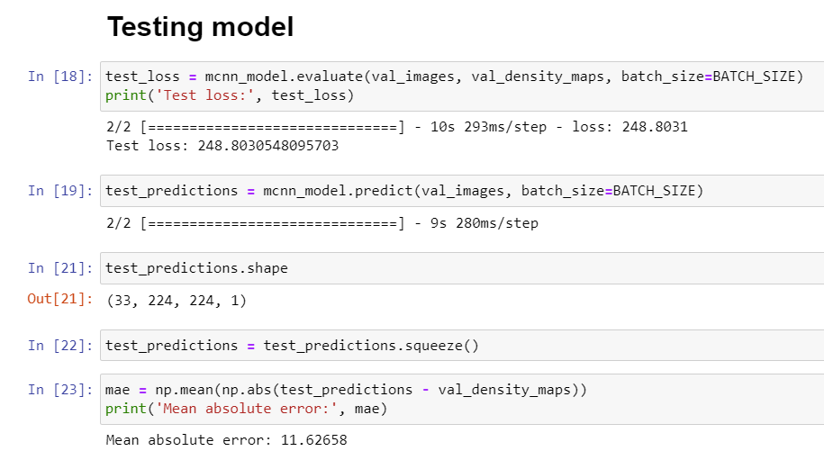
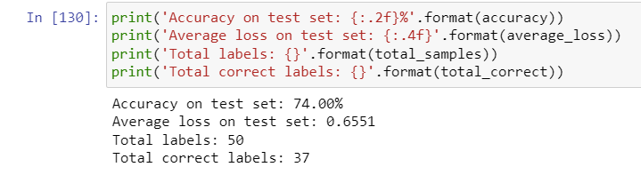
IMAGE CLASSIFICATION -- Model Comparison
CSRNet
DenseNet

Slide 35
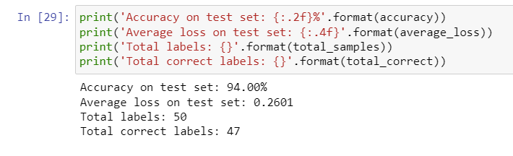
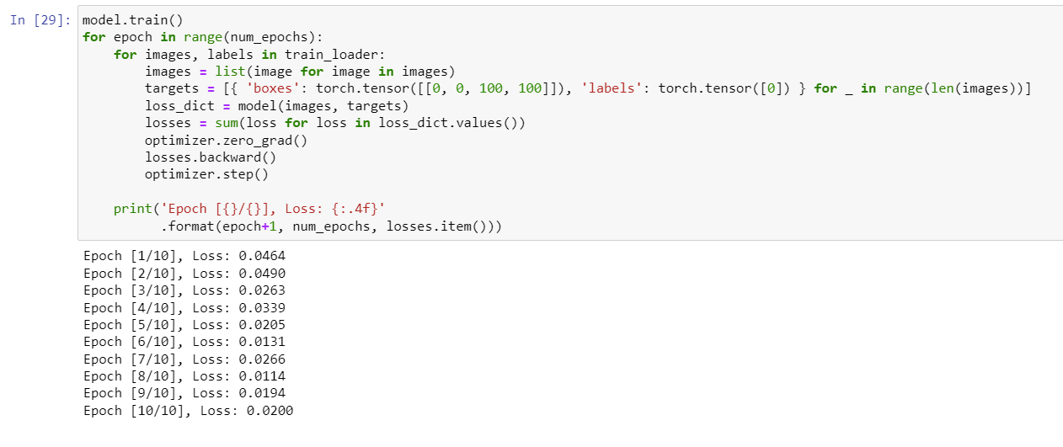
IMAGE CLASSIFICATION -- MODEL COMPARISON
DenseNet with 50 epoch
Faster RCNN

Slide 36
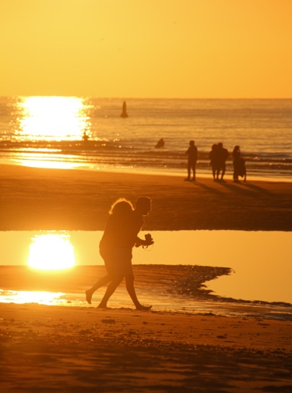
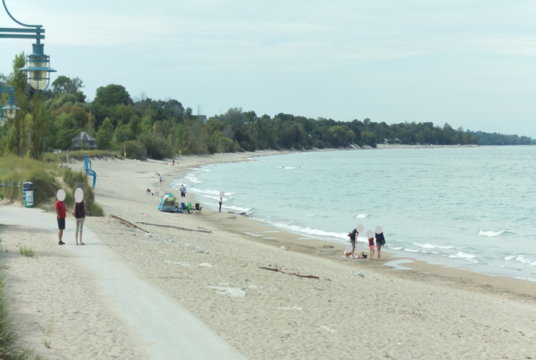
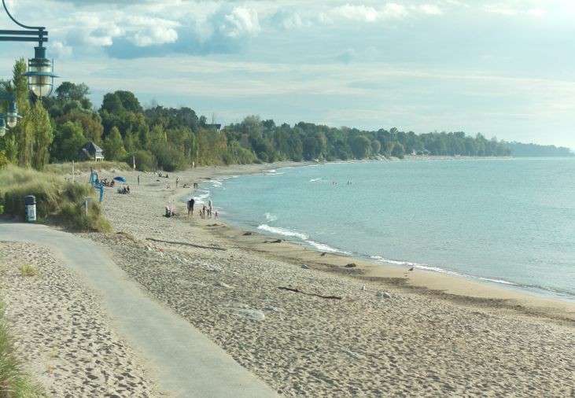
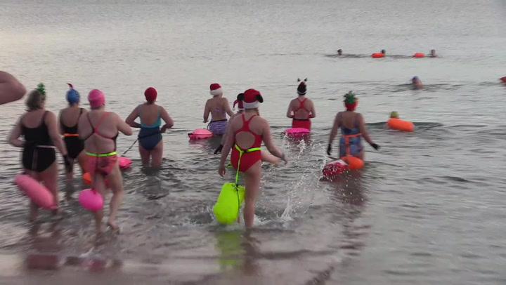
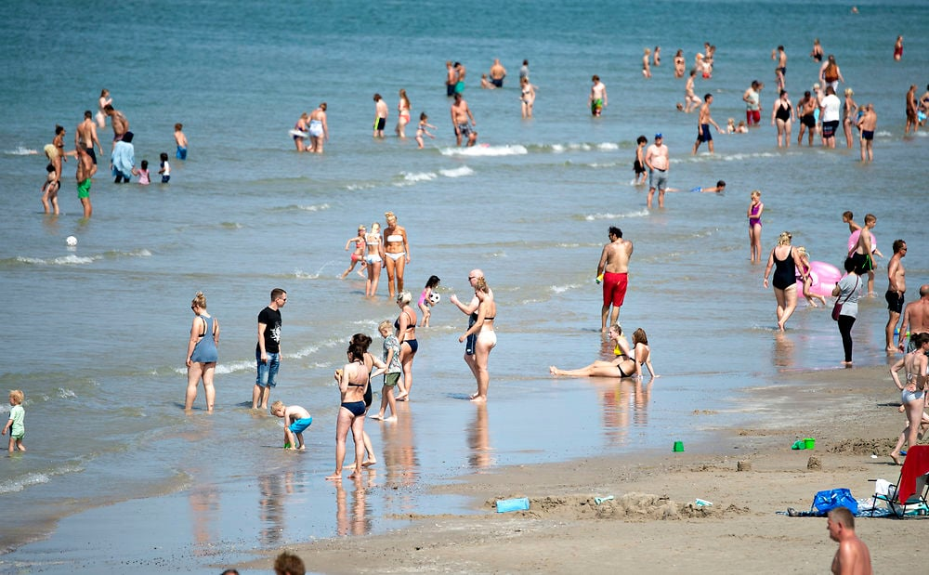
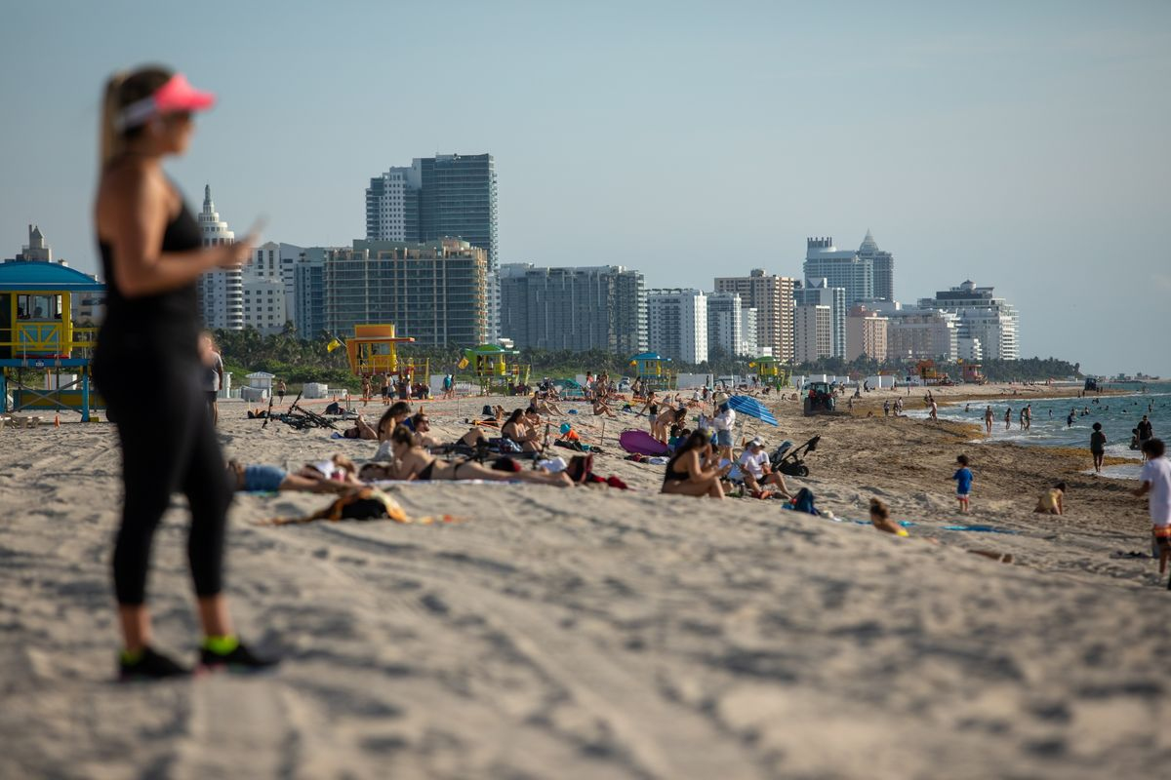
Image Classification -- results
Class : 0​
Class : 1
Class : 2
Bruce Beach(n.d.)
Bruce Beach(n.d.)
Steven(2021)
Jayme(2020.6)

Slide 37
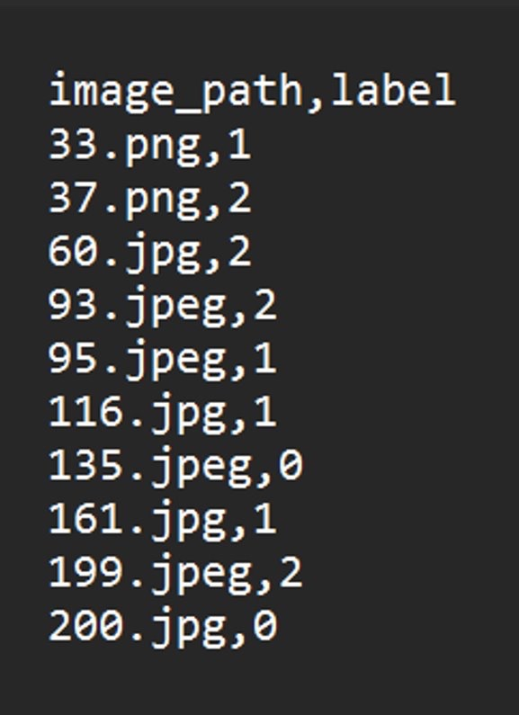
Image Classification -- result
As we can see here the model provides a CSV file including the predicted labels and image file name.​
In the latest model this phase is eliminated since we were able to train just one model which works best for the beach data.

Slide 38
architecture
Face anonymizing
Image annotation
Model training/validation
Image classification
Object detection

Slide 39
The resuts on object detection
9
Here we come to the last stage:
The detection

Slide 40
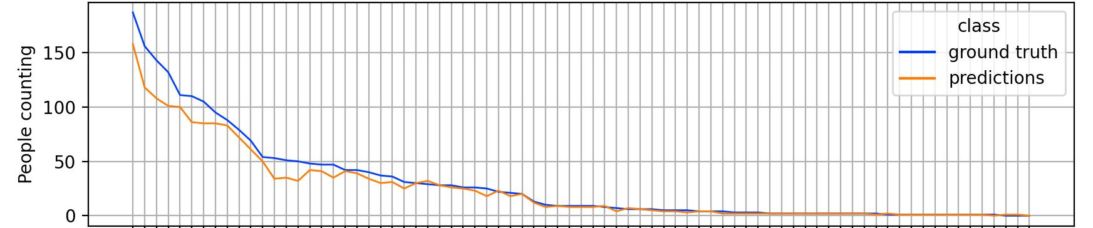
Object detection accuracy
Here is the statistics of how accurate our final prediction is
People in image​ | Ground truth​ | ​prediction | ​accuracy
150+​ | ​171.5 | ​138.0 | ​80.5%
​100-150 | ​120.2 | ​96.0 | ​79.9%
50-100 | 69.9 | 60.0 | 85.8%
10-50 | 31.9 | 28.7 | 90.0%
0-10 | 3.3 | 3.0 | 91.0%

Slide 41

Future work

Slide 42
Future work
YOLOv8 model used for object detection can be extended to count people in water and in shore by segmenting the images.
The same model YOLOv8- RIP algorithm can be used for wave RIP current predicitions from images.
A Qualitative measure can be used for the images which can generate type-I error. (This can be used as temporary solution for those kind of images, training the model on that particular type of images is still advisable.

Slide 43
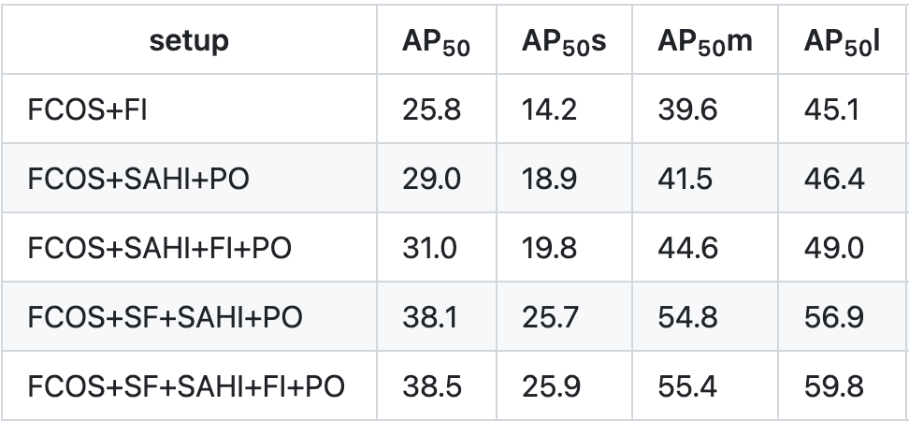
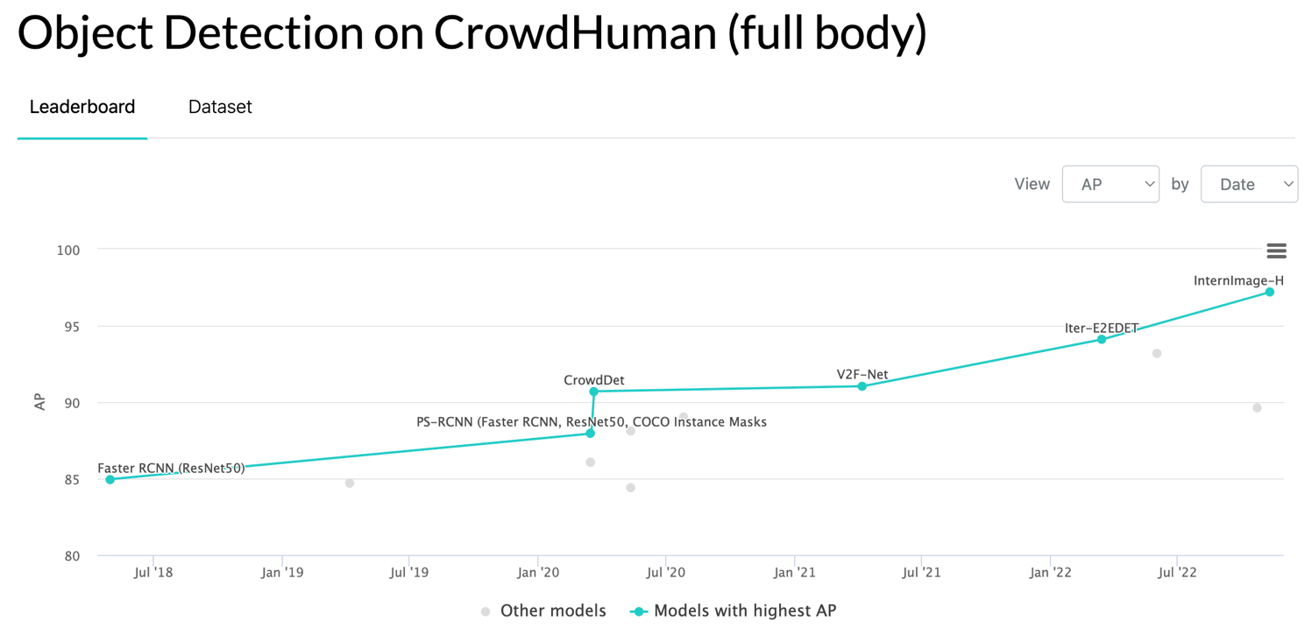
Performance improvement
Trying a two-stage model instead of a one-stage model
Enhancing the model's generalization ability and the detection ability of small objects:
FI(Full Inference)
PO(Patch Overlap)
SF(Slicing Aided Fine-tuning)
SAHI(Slicing Aided Hyper Inference)
Keeping up with the latest techniques and improvements from the benchmark: Object Detection on CrowdHuman(full body)
Try DotD instead of IoU on TOD(Tiny Object Detection) challenges
https://github.com/fcakyon/small-object-detection-benchmark
https://paperswithcode.com/sota/object-detection-on-crowdhuman-full-body

Slide 44

Q & A or comments

Slide 45

Thank you

